Slide 1

Airline Passenger Satisfaction Survey
Aswin

Slide 2



Agenda
Introduction
EDA
Methods
Conclusion
References

Slide 3



Introduction

Slide 4


Introduction
EDA
Airline Passenger Satisfaction dataset contains the survey about the satisfaction of customer.
The factors that are correlated to the customer satisfaction is determined. The factors includes seat comfort, leg room service, cleanliness, .etc.
Exploratory data analysis has provided the correlation between variables.
Average age of passengers in 39.
The passenger with the lowest age is 7 and the age of oldest passenger is 85.
On a scale of 5, average Wi-Fi service satisfaction is 2.72
Average of Food & Drink is found to be 3.21
Average of Seat Comfort is found to 3.44
Average of Leg room service is 3.35

Slide 5
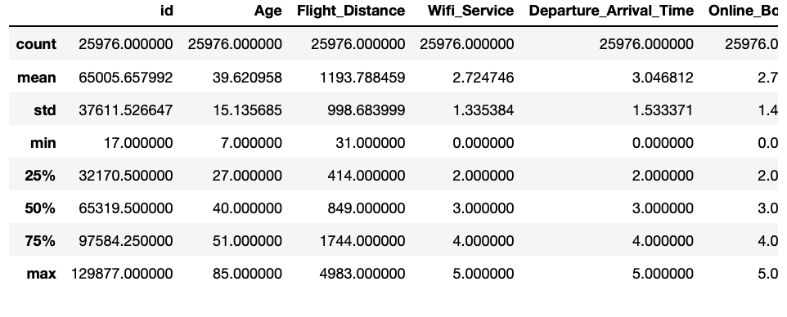
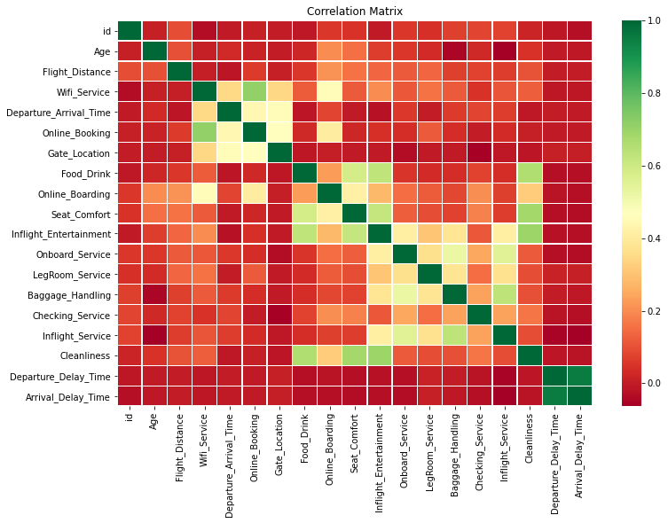
EDA
Glimpse of the dataset
Correlation Matrix
Average, minimum, count, standard deviation of the features are found.
Food drink, gate location, seat comfort, onboard service, etc. are some the features for which we can find the average.

Slide 6

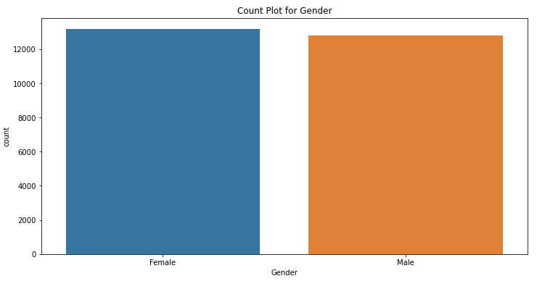
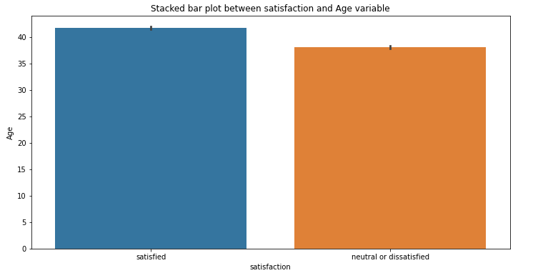
EDA
Univariate Analysis for count
Bivariate Analysis
Gender - More number of Female Passengers.
Customer Type – More number of loyal customers.
Travel Type – More number of Business travel passengers.
Satisfaction – Less number of satisfied passengers.
Average age of satisfied passengers is 42 & neutral or dissatisfied passenger is 37.
Avg age of Male & Female passengers is 37.
Avg age Loyal Customers is 42 and disloyal passenger is 29.
Avg age of business travel passengers is 39 and personal travel passengers is 38.

Slide 7

Methods

Slide 8
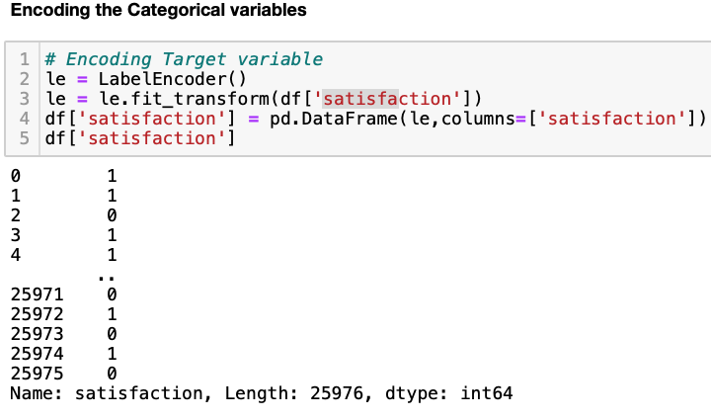
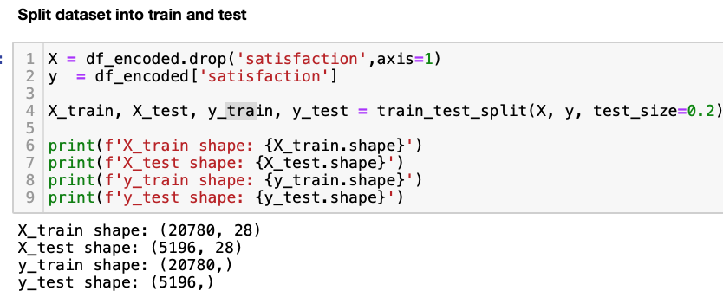
ENCODING & SPLITTING THE DATA SET

Slide 9
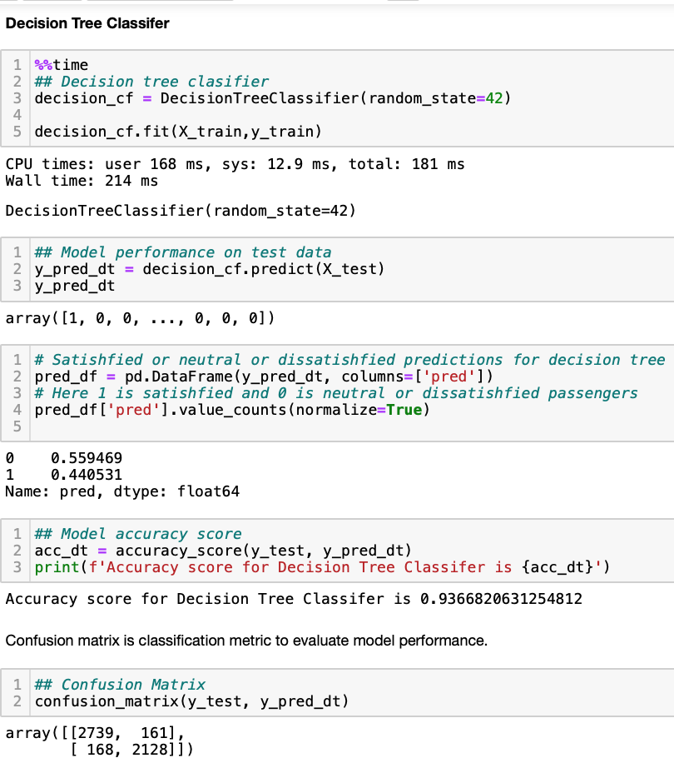
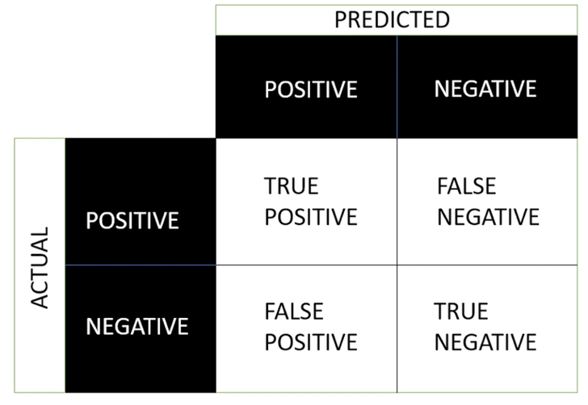
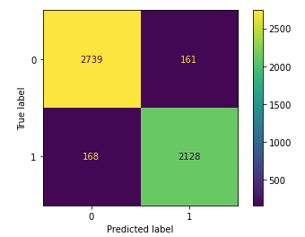
DECISION TREE CLASSIFIER
CONFUSION MATRIX

Slide 10
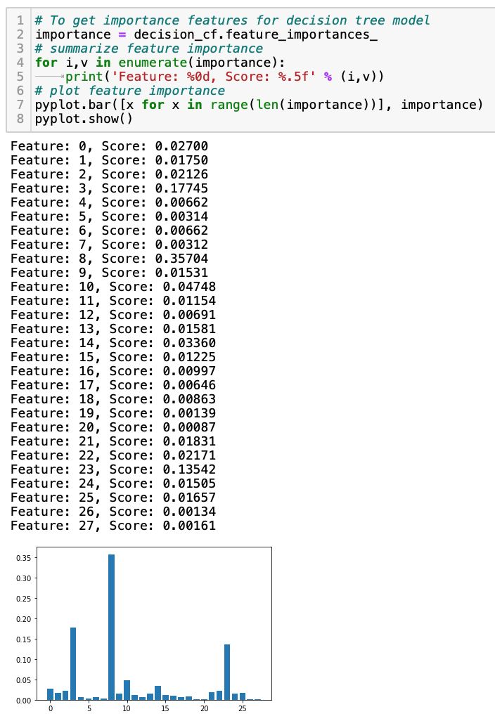
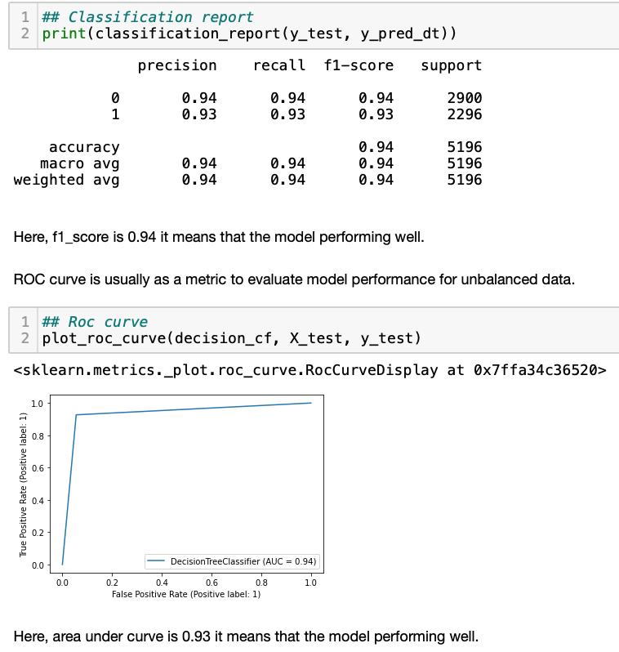
DECISION TREE CLASSIFIER
IMPORTANCE FEATURES

Slide 11
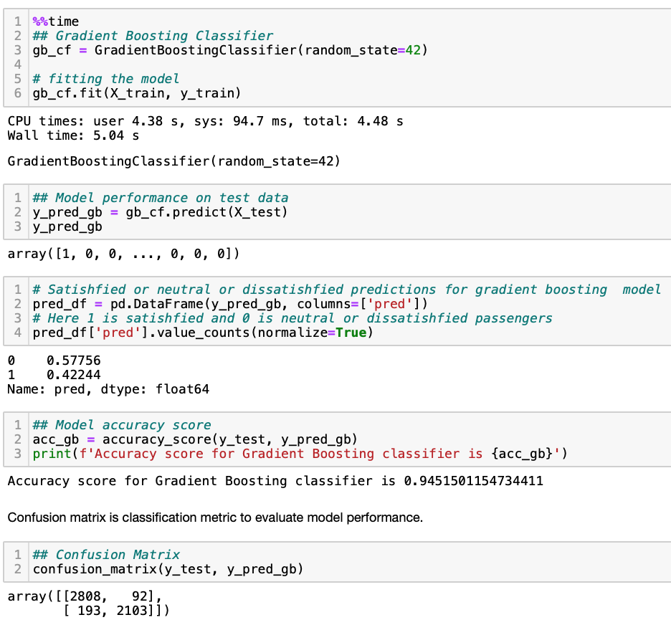
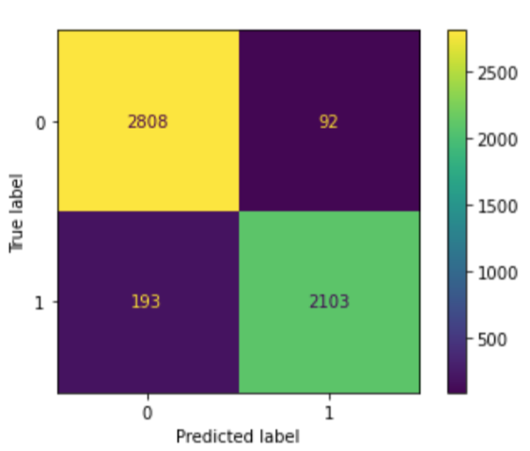
GRADIENT BOOSTING CLASSIFIER
CONFUSION MATRIX

Slide 12
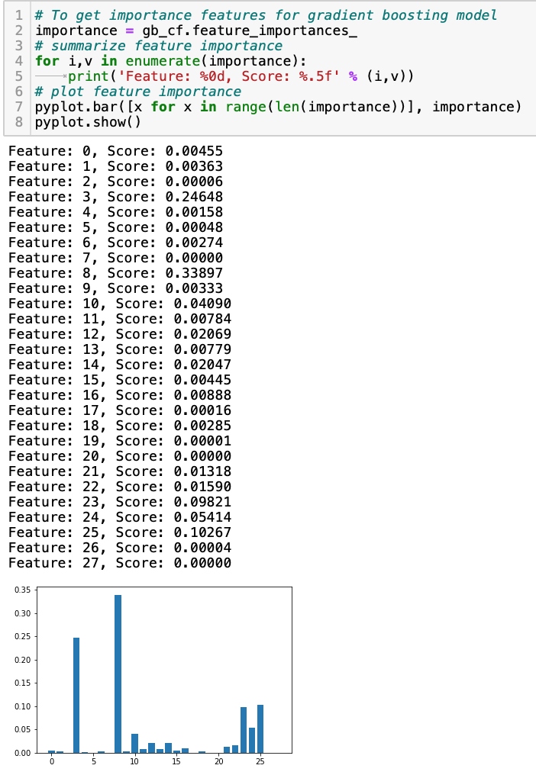
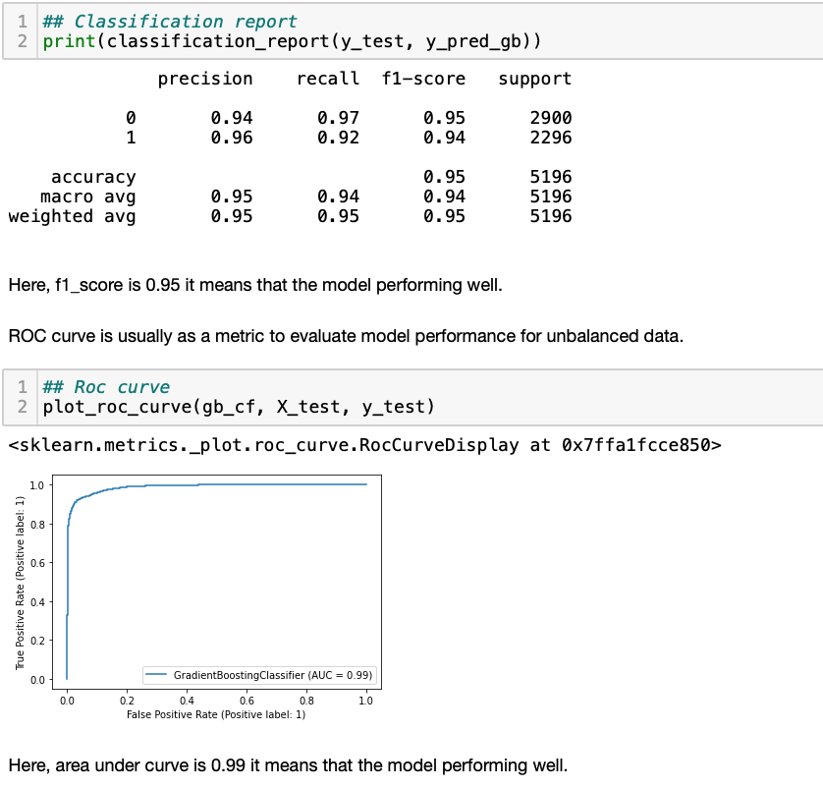
GRADIENT BOOSTING CLASSIFIER
IMPORTANCE FEATURES

Slide 13
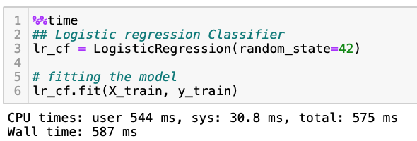
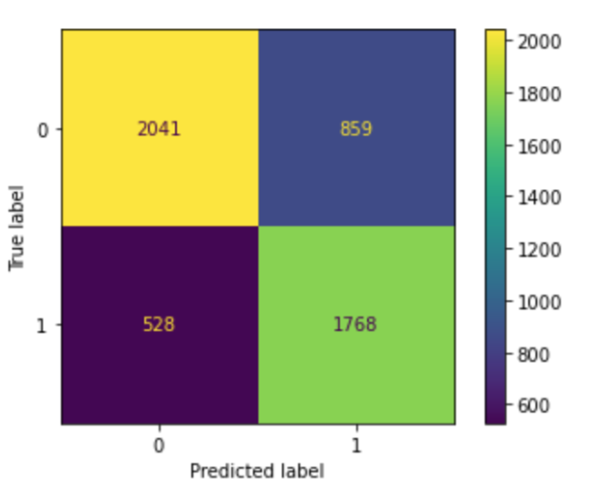
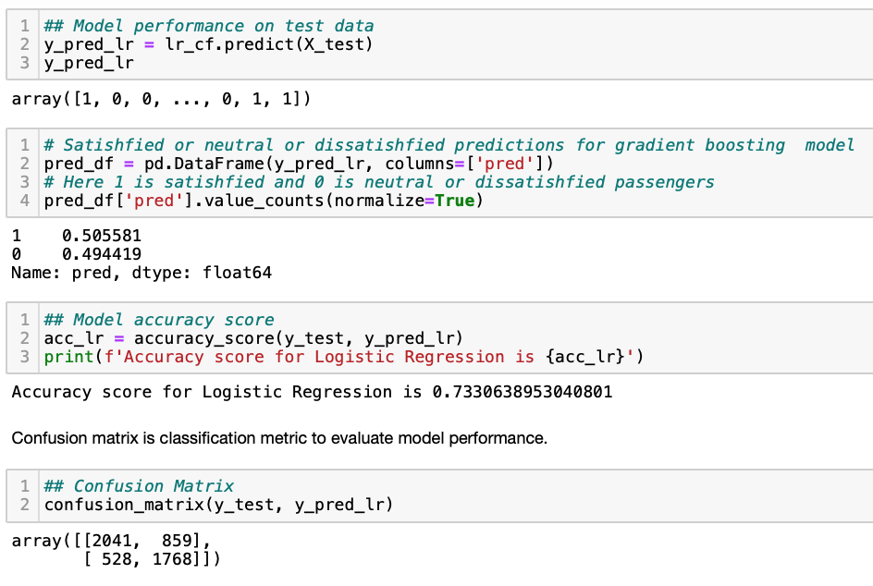
LOGISTIC REGRESSION CLASSIFIER
CONFUSION MATRIX

Slide 14
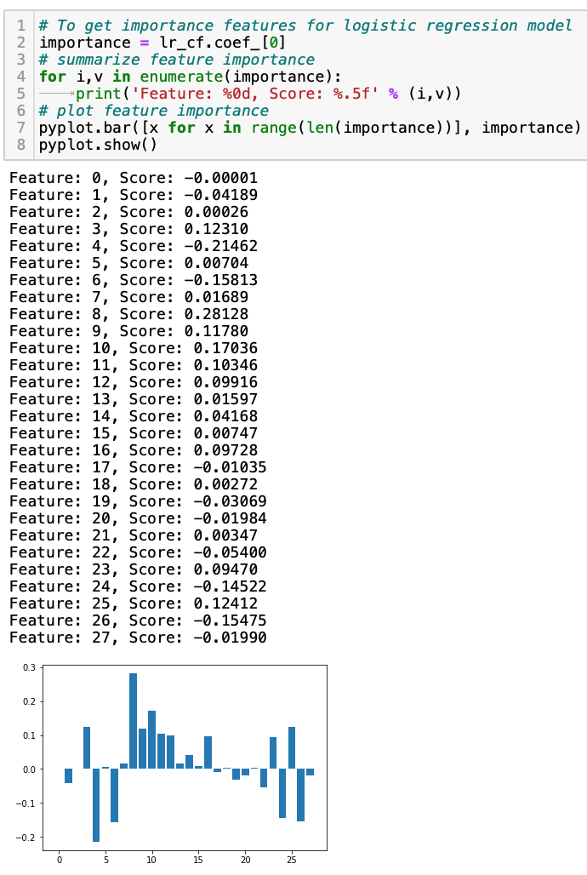
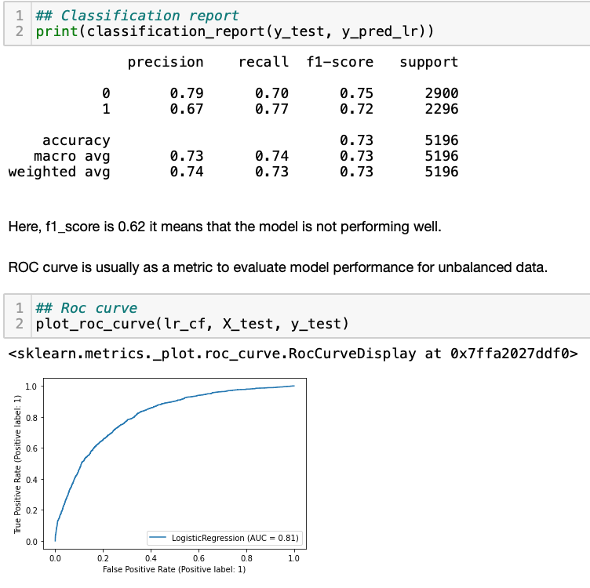
LOGISTIC REGRESSION CLASSIFIER
IMPORTANCE FEATURES

Slide 15
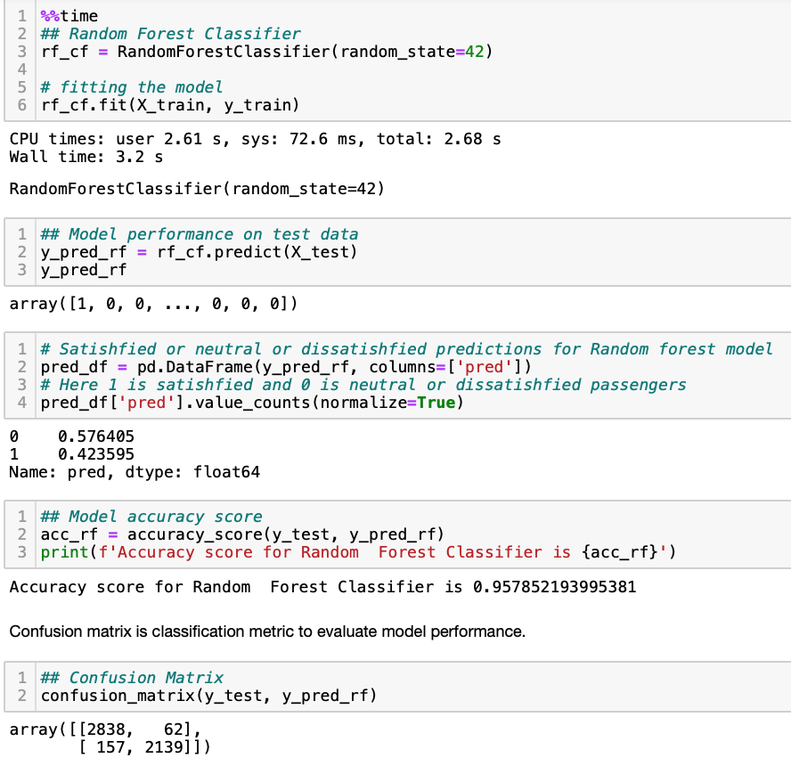
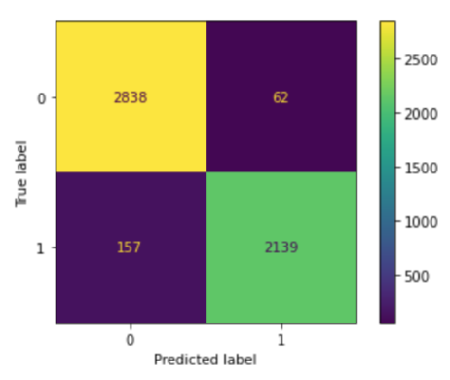
RANDOM FOREST CLASSIFIER
CONFUSION MATRIX

Slide 16
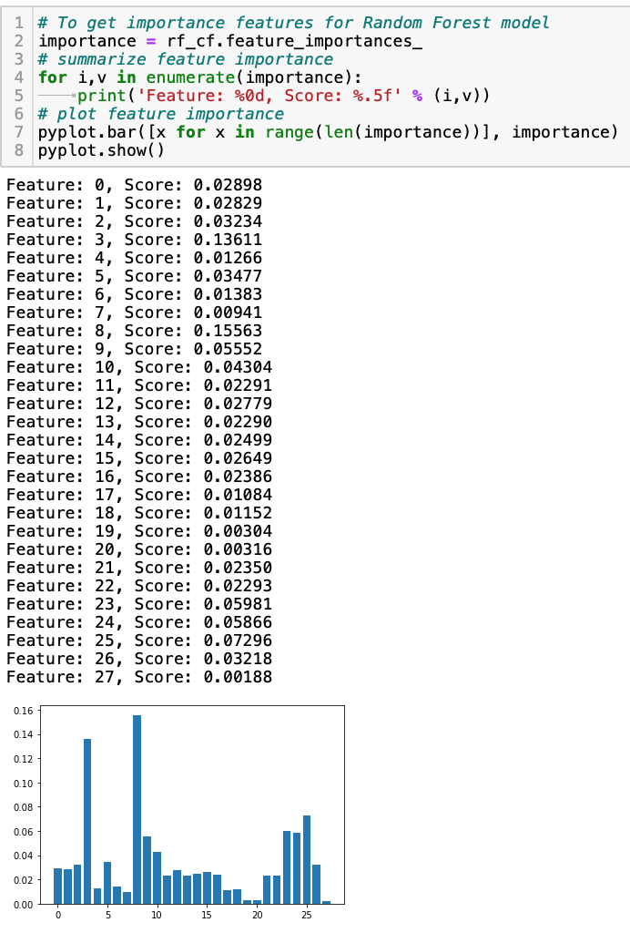
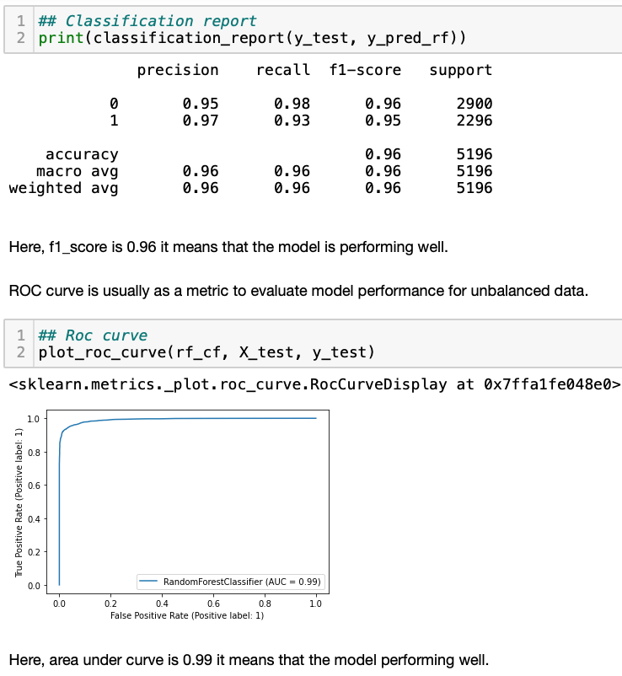
RANDOM FOREST CLASSIFIER
IMPORTANCE FEATURES

Slide 17
COMPARING MODELS
Model | Accuracy | F1-Score | AUC
Decision Tree Classifier | 0.93 | 0.94 | 0.94
Gradient Boosting Classifier | 0.94 | 0.95 | 0.99
Logistic Regression Classifier | 0.73 | 0.73 | 0.81
Random Forest Classifier | 0.95 | 0.96 | 0.99

Slide 18
CONCLUSION
A total of 4 models was used to find the accuracy, f1 score and AUC.
Most Accurate model: Random Forest Classifier with accuracy of 0.95
Importance features were found for each model that contribute to the prediction.

Slide 19
References:
Bronshtein, A. (2019, October 29). A Quick Introduction to the "Pandas" Python Library. Medium. Retrieved from: https://towardsdatascience.com/a-quick-introduction-to-the-pandas-python-library-f1b678f34673
Htoon, K. S. (2020, July 3). A Guide to KNN Imputation. Medium. Retrieved from: https://medium.com/@kyawsawhtoon/a-guide-to-knn-imputation-95e2dc496e
Kaushik. (2020, July 20). KNNImputer: Way To Impute Missing Values. Analytics Vidhya. Retrieved from: https://www.analyticsvidhya.com/blog/2020/07/knnimputer-a-robust-way-to-impute-missing-values-using-scikit-learn/
10 minutes to pandas. 10 minutes to pandas - pandas 1.3.0 documentation. (n.d.). Retrieved from: https://pandas.pydata.org/docs/user_guide/10min.html#missing-data
Matplotlib Pyplot. (n.d.). Retrieved from: https://www.w3schools.com/python/matplotlib_pyplot.asp
Borcan, M. (2020, March 21). Decision tree classifiers explained. Medium. Retrieved from: https://medium.com/@borcandumitrumarius/decision-tree-classifiers-explained-e47a5b68477a
SalRite. (2018, December 18). Demystifying 'confusion matrix' confusion. Medium. Retrieved from: https://towardsdatascience.com/demystifying-confusion-matrix-confusion-9e82201592fd
NORTHEASTERN UNIVERSITY

Slide 20
Thank You

